Slide 1
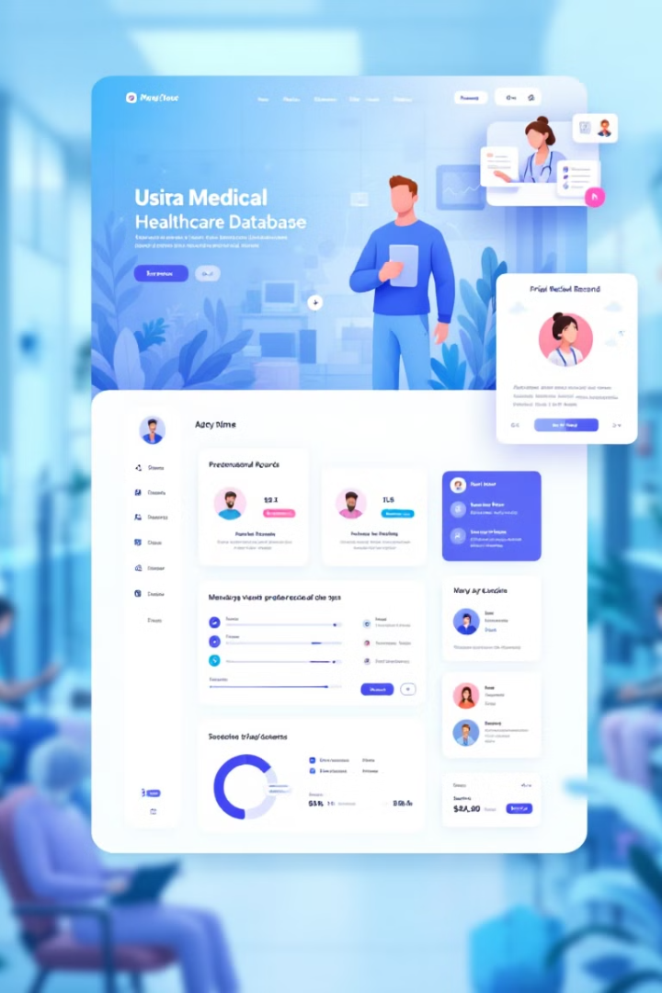
H.E.A.L. (Healthcare Efficiency & Assistance Log)
PHASE 4-FINAL PRESENTATION
NAME NEU ID
DARSHAN PATIL 002814840
SAMARTH BHOGTE 002396427
SHREYASH YADAV 002849048

Slide 2




Welcome to H.E.A.L.
A healthcare database system designed to streamline hospital processes.
Built with a secure, scalable Oracle-based database architecture.
Secure Database
Healthcare Focus
Streamlined Processes
Oracle-based system with robust security protocols
Tailored for medical facility workflows
Automation of critical administrative tasks

Slide 3

Problem Statement - H.E.A.L.
Inefficient Workflows
Healthcare facilities often struggle with inefficient administrative workflows, fragmented patient records, delayed billing processes, and limited role-based access to sensitive medical data. These inefficiencies increase operational costs and impact patient care, data security, and overall hospital productivity.
The Solution
There is a critical need for a centralized, secure, and automated database system that can streamline core healthcare operations like patient registration, appointment scheduling, treatment tracking, and billing - while maintaining strict access control for different user roles.

Slide 4
Team Roles & Contributions
Team Member
Contributions
Darshan Patil
Package, indexes, procedures, merges
Shreyash Yadav
View test cases, role enforcement, grants
Samarth Bhogte
Views, constraint testing, triggers, user creation

Slide 5
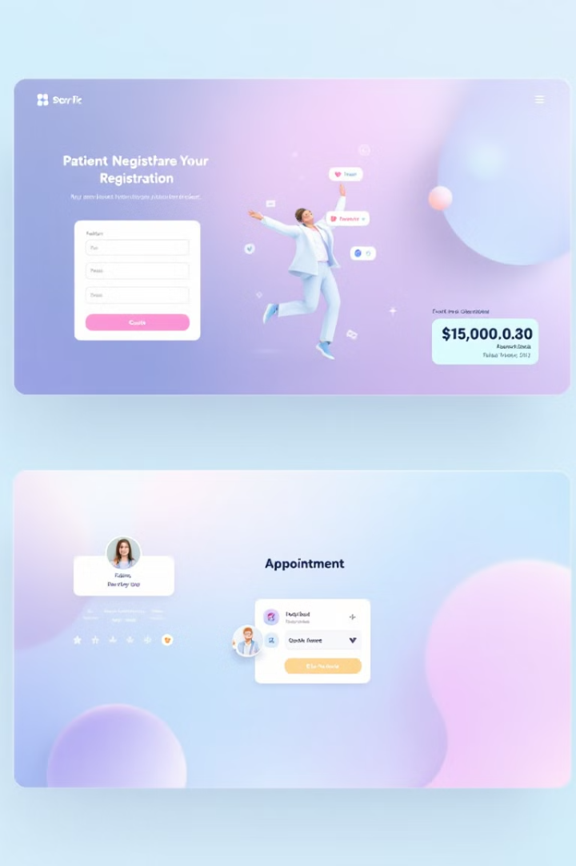



Project Summary
Purpose
Features
Automate healthcare workflows for improved efficiency
Registration, Appointments, Treatment, Billing
Tech Stack
Oracle SQL, PL/SQL, GitHub

Slide 6
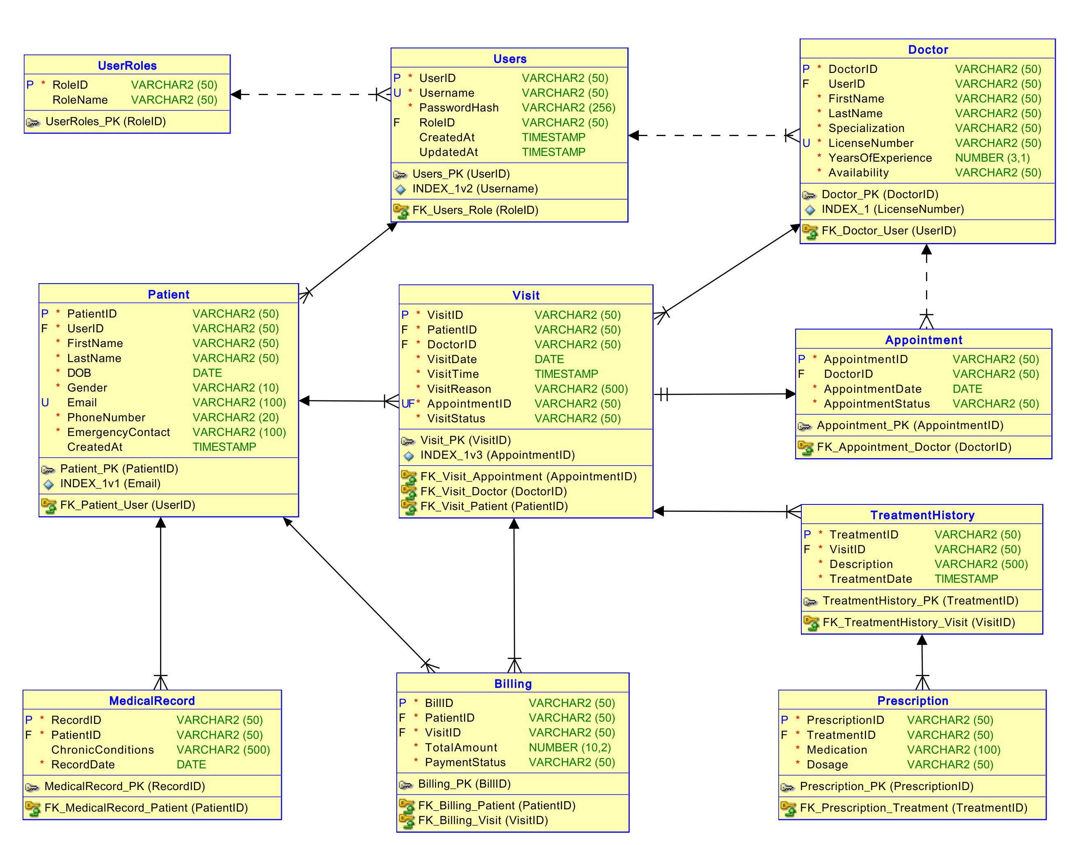
Logical & Physical Models
ER Diagram
Normalization
Implementation
Complete with primary and foreign key relationships
Data normalized from UNF to BCNF for optimal structure
Datatypes and constraints defined for data integrity
REFRENCES:
Caption

Slide 7
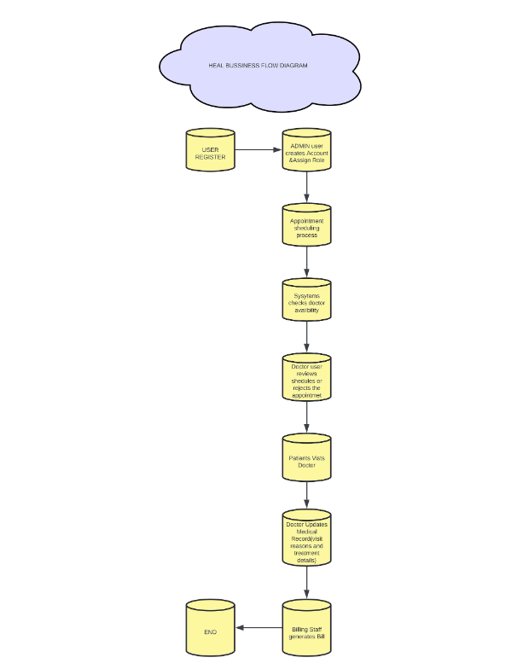
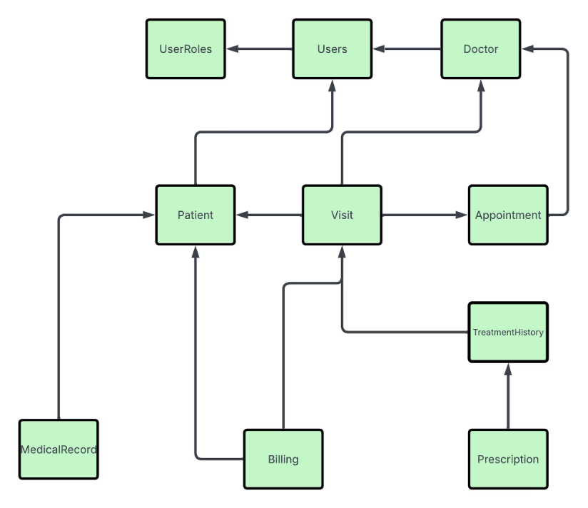

Slide 8










Schema & Object Overview
Users & Roles
Tables
RBAC implemented
With constraints (PK, FK, CHECK)
Views
Doctor availability, billing, visit summary
Triggers
Auto-actions & validation
Indexes
On critical fields

Slide 9

Centralized Procedures & Package
Key Procedures
Exception Handling
1
Update_Visit_Status
Robust EXCEPTION blocks capture system and user-defined errors.
Updates the status of a patient visit
RAISE_APPLICATION_ERROR provides precise feedback on business logic issues.
2
Complete_Payment
Marks a billing record as paid
3
Record_Treatment
Logs treatment details for a visit
4
Schedule_Appointment
Manages doctor availability and patient scheduling
All procedures centralized in the healthcare_pkg for modular design.

Slide 10

Testing Scenarios
Data Operations
Insert/Update/Delete operations validated across tables
Error Handling
Constraint violations tested with custom error messages
Trigger Validation
Auto treatment validation confirmed on data changes
Script Execution
views.sql, constraint_testing.sql, v_test_procedure.sql

Slide 11






Version Control with GitHub
Branch-based Development
Feature branches for parallel work
Regular Check-ins
Consistent commits from all team members
Documentation
Screenshots and logs maintained
We maintained project discipline through GitHub. All scripts were versioned and pushed progressively—not last minute.

Slide 12

Healthcare Database System Implementation
A comprehensive walkthrough of our secure database implementation for healthcare management

Slide 13
Process Flow & DFD
Patient
Registration and data entry
Visit
Appointment scheduling and documentation
Treatment
Medical procedures and prescriptions
Billing
Invoice generation and payment processing

Slide 14

Project Takeaways
Database Design
Security Implementation
Clean schema with proper normalization
Secured procedures with role-based access
Quality Assurance
Fully tested scripts and validation reports

Slide 15
REFRENCES:
EHR Impact on Care Quality Paolo Campanella, Emanuela Lovato, Claudio Marone, Lucia Fallacara, Agostino Mancuso, Walter Ricciardi, Maria Lucia Specchia, The impact of electronic health records on healthcare quality: a systematic review and meta-analysis, European Journal of Public Health, Volume 26, Issue 1, February 2016, Pages 60– 64, https://doi.org/10.1093/eurpub/ckv122
AI & RPA-Driven Workflow Automation • Sharma V. “Automating Complex Healthcare Workflows with AI and RPA: A New Era of Efficiency” (Feb 2023). International Journal of Leading Research and Publication, Vol 4 Issue 2. https://www.ijlrp.com/research-paper.php?id=1249 IJLRP
Policy & Background Report • Office of the National Coordinator for Health IT. “Health IT Workflow Automation – Background Report” (July 2021). U.S. Department of Health and Human Services. https://www.healthit.gov/sites/default/files/topiclanding/2021- 07/Workflow_Automation_Background_Report_FINAL.pdf HealthIT.gov
RPA in Healthcare • Lahane K.K., Sutar A.A. “AUTOMATION IN HEALTHCARE USING RPA” (Jan 2021). International Research Journal of Modernization in Engineering, Technology and Science, Vol 3 Issue 1. https://www.irjmets.com/uploadedfiles/paper/volume3/issue_1_january_2021/5962/1628083245.pdf IRJMETS
IoT & AI-Enhanced Scheduling • IJCRT Research Team. “Enhancing Doctor Appointment Scheduling Using IoT And AI” (Mar 2024). International Journal of Creative Research Thoughts, Vol 12 Issue 3. https://ijcrt.org/papers/IJCRT24A3362.pdf IJCRT
THANK YOU

